Slide 1
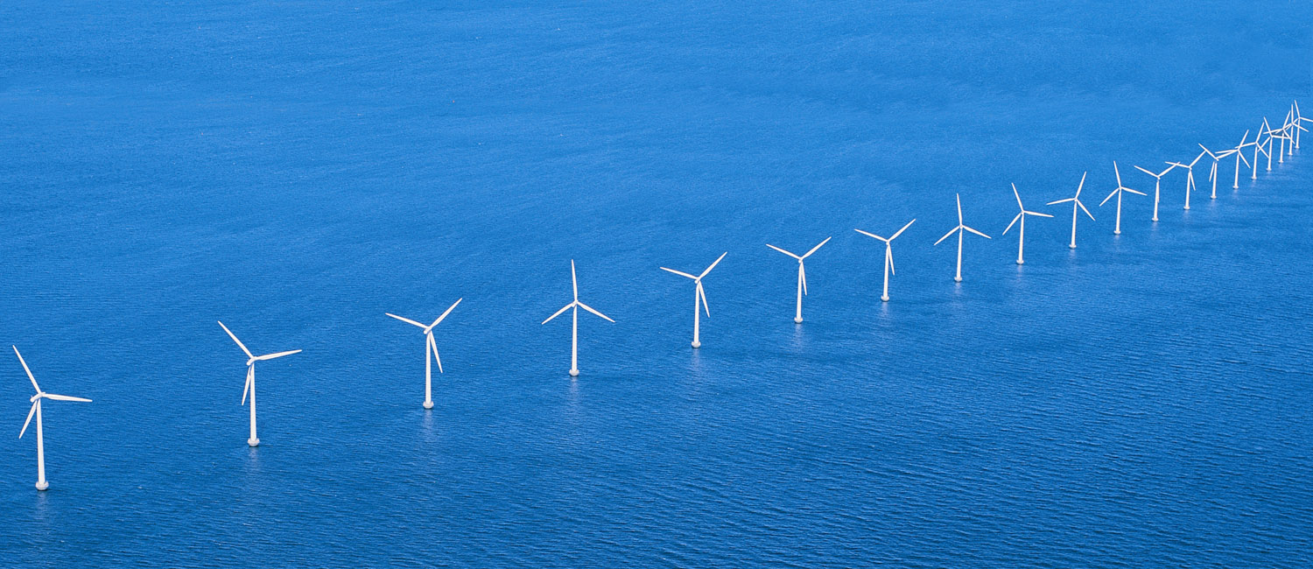
The European offshore wind industry key trends and statistics 2010
Athanasia Arapogianni
Research officer
The European Wind Energy Association
16/03/2011

Slide 2
Outline
Latest offshore wind developments
R&D landscape
European Wind Initiative (EWI)

Slide 3
2010 offshore wind power market
308 new offshore wind turbines installed
883 MW in total – increased by 51% on the previous year
Eight wind farms were fully completed and grid connected
One wind farm partially completed and grid connected
One wind farm completed but not grid connected

Slide 4
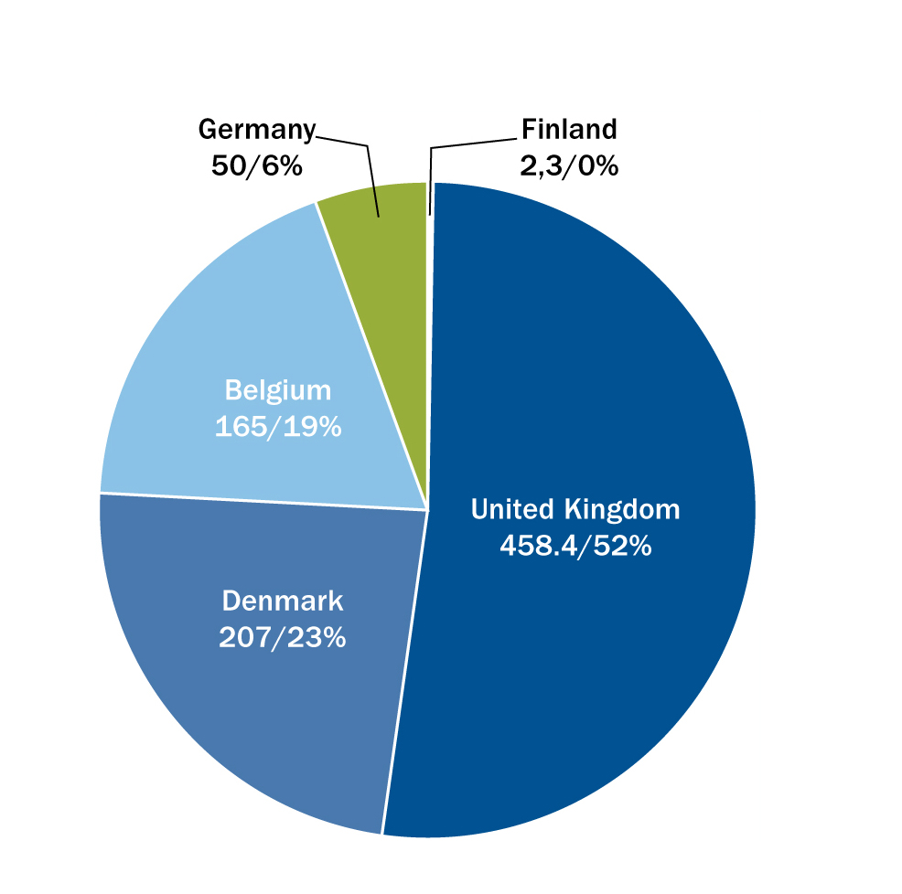
2010 offshore wind power market
INSTALLED CAPACITY: SHARE OF 2010 INSTALLATIONS (MW)
FOUNDATION TYPE IN 2010 OFFSHORE WIND FARMS
Notes:
The share of 2010 installations in terms of capacity and manufacturers can be seen in these two graphs. UK was leading in installed capacity followed by Denmark Belgium Germany and Finland. Looking in the foundation types, monopiles prevailed in 2010, followed by gravity structures jacket, tripile and finally one Floating wind turbine in Norway.

Slide 5
Cumulative Market
1,136 turbines installed and grid connected
2,946 MW in total
45 wind farms in nine European countries
Produces 11.5 TWh of electricity in a normal year
Average wind turbine size 3.2 MW

Slide 6
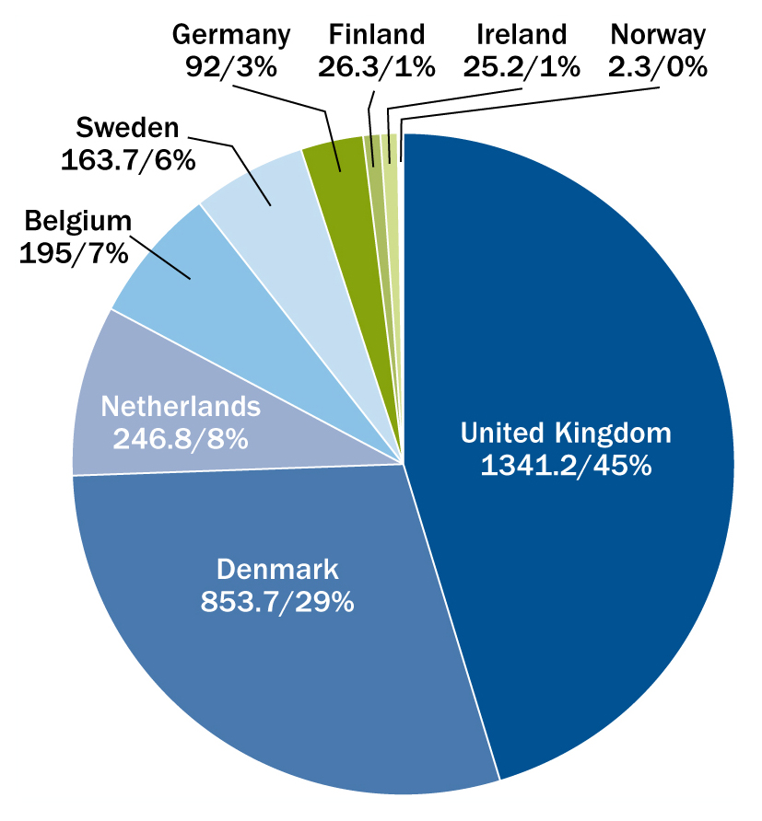
Cumulative Market
INSTALLED CAPACITY: CUMULATIVE SHARE BY COUNTRY AT END 2010 (MW)

Slide 7
Market outlook: 2011 and beyond
EWEA forecasts that between 1,000 and 1,500 MW of new offshore wind capacity will be fully grid connected in Europe during 2011
10 wind farms, totalling 3,000 MW, are currently under construction. When completed, Europe’s installed offshore capacity will increase to 6,200 MW
19,000 MW are currently fully consented

Slide 8
Trends: turbines, water depth and distance to shore
The average offshore wind farm size in 2010 was 155.3 MW, up from 72.1 MW the previous year
Average water depth in 2010 was 17.4m, a 5.2m increase on 2009, with projects under construction in water depth averaging 25.5m
Average distance to shore increased in 2010 by 12.7 km to 27.1 km substantially less, however, than the 35.7 km average for projects currently under construction.

Slide 9
R&D landscape – International and Central national institutions covering offshore wind
Research Areas | Project (name/country/Research team)
Resource assessment (6) | Wind power meteorology/DK/Risoe
 | Flow/DK/Risoe
 | Wind Resource Assessment/CA/WESNet
 | Ocean Wind Characteristics/JP/NEDO
 | Wake effects/CN/WED
 | Wind study in complex terrain/CN/WED
Supply issues (3) | Improved vessels/EU/TP wind
 | Better access methods/EU/TP wind
 | Wind power services/CN/GTZ
O&M (3) | Operation and maintenance strategies and technologies/NO/NOWITECH
 | Operation and maintenance optimisation/NL/ECN
 | Operation and maintenance/CN/GTZ

Slide 10
Research Areas | Project (name/country/Research team)
Wind Turbine technology and new concepts (18) | Offshore substructures, new offshore turbines/EU/TP wind
 | Aeroelastic modelling/DK/Risoe
 | New concepts, components and materials/DK/Risoe
 | Integrated numerical design tools/NO/NOWITECH
 | Energy conversion systems/NO/NOWITECH
 | Novel substructures/NO/NOWITECH
 | novel concepts for offshore wind turbines/NO/NOWITECH
 | Aerodynamic performance/NL/ECN
 | Integrated wind turbine design/NL/ECN
 | Materials & Structures/NL/ECN
 | Turbine operation in complex terrain/GR/CRES
 | Wind Energy Extraction/CA/WESNet
 | Wind power engineering/CA/WENet
 | Technologies for ocean wind observation/JP/NEDO
 | Coupled vibration of wind turbines and substructures/JP/NEDO
 | Floating wind turbines/JP/NEDO
 | Advanced Component Technology/US/NWTC
 | Task 23/20 member countries,EC,EWEA/IEA

Slide 11
Research Areas | Project (name/country/Research center)
Energy System integration and grid developments (4) | Wind power and the energy system/DK/Risoe
 | Grid connection and system integration/NO/NOWITECH
 | Modelling of the hourly dispatch/CN/WED
 | Grid Integration/US/NWTC
Economics (3) | Provide cost-effective and commercial RE/CN/CRESP
 | Techno-economic aspects of wind energy/CA/WESNet
 | Optimisation and cost reduction/DK/Risoe
Others (7) | Training and applied research/CN/GTZ
 | Information and advice/CN/GTZ
 | Guidance and requirement for wind turbine selection/CN/WED
 | Training on wind power prediction physical approach/CN/WED
 | Renewable energy policy development/CN/CRESP
 | Energy scale-up/CN/CRESP
 | Replace coal-fired generation/CN/CRESP
TOTAL = 44

Slide 12
R&D landscape – Individual national and international programmes
EU
Upwind | The project looks at the design of very large wind turbines, both onshore and offshore.
RELIAWIND | Aim: achieve better efficiency for wind turbines, through the deployment of new systems with reduced maintenance requirements and increased availability
PROTEST | Aim: Develop a methodology that enables better specification of design loads for the mechanical components of turbines.
NIMO | Integrated condition monitoring system → eliminate catastrophic failures minimise the need for corrective maintenance
Wingy -Pro | Demonstration of the first ever large size transversal flux generator in an existing wind turbine.
SEANERGY | National and international Maritime Spatial Planning (MSP) practices, policy recommendations for developing existing and potentially new MSP for the development of offshore renewable power generation, and promote acceptance of the results.
OffshoreGrid | Techno-economic study which will develop a scientifically based view on an offshore grid in Northern Europe along with a suited regulatory framework considering technical, economic, policy and regulatory aspects.
Marina Platform | Set of equitable and transparent criteria for the evaluation of multi-purpose platforms for marine renewable energy (MRE).

Slide 13
R&D landscape – Individual national and international programmes
DE
Project | Short description
 | OGOWin | OGOWin – “Optimization of jacket foundation structures for offshore wind power stations concerning material consumption, assembling order and manufacturing process”
 | RAVE | The RAVE research initiative runs simultaneously with the construction and operation of the "alpha ventus" test site to attain broad based experience and knowledge for future offshore wind parks.
 | WEMP | The Offshore-WEMP project will gather and evaluate data and provide collaboration between operators, manufacturers, scientists, and other involved parties with the opportunity to gain basic insights into offshore wind energy in terms of reliability and availability and to address larger political questions. It is planned as a long-term project for monitoring the offshore wind energy deployment in Germany.

Slide 14
R&D landscape – Individual national and international programmes
NL
Project | Short description
We@Sea | The aim of We@Sea is to gather knowledge and reduce risks, in order to realize a sound implementation of wind energy in the North Sea.
Flow | The Far and Large Offshore Wind program (FLOW) consists of an ambitious R&D plan and a demonstration wind farm 75 km off the Dutch coast, in 35 meters water depth. FLOW aims to accelerate the development of offshore wind energy and to reduce the associated cost

Slide 15
R&D landscape – Individual national and international programmes
UK
Project | Short description
ETI | ETI, the Energy Technologies Institute, is a 50:50 partnership between government and industry and facilitates collaborative R&D.
NAREC | NAREC provides an independent centre for the development, testing and commercialisation of next generation technologies for the global wind energy industry
DECC ETF | The 3rd call of DECC's Environmental Transformation Fund (ETF) aims to support, stimulate and encourage the development and demonstration of offshore wind technologies and components
COWRIE | COWRIE (Collaborative Offshore Wind Research Into The Environment) is a registered Charity set up to advance and improve understanding and knowledge of the potential environmental impacts of offshore windfarm development in UK waters.

Slide 16
R&D landscape – Individual national and international programmes
Project | Short description
SE | Vindforsk III | Vindforsk III is a co-financed research programme that provides funding for basic and applied research covering wind energy.
ES | Zèfir | The objective is to create an international test plant in Spain. The project, sponsored by the Institute of Energy Research of Catalonia (IREC), aims to become a benchmark in research for the installation of deepwater wind turbines.

Slide 17
Research networks
EU | EAWE
 | ORECCA
ES | REOLTEC
DK | Megavind
NL | INNWIND
More information : Handouts available

Slide 18
The European Wind Initiative (EWI)
Wind energy R&D funding : 2010 – 2020 period
Aim: improved and increased public funding for wind energy R&D
History:
One of the goals of the EU Strategic Energy Technology Plan (SET-Plan), was to launch European Industrial Initiatives (EIIs), i.e. Programmes for fostering R&D in 8 strategic energy sectors:
Wind | Bio-energy
Solar | Energy efficiency
Nuclear | Smart grids
CCS | Hydrogen and fuel cells
The EWI is rooted in the SET-Plan, a 2007 blueprint for the development of low-carbon technologies, and it was produced by TPWind in cooperation with EU Institutions and Member States

Slide 19
The European Wind Initiative (EWI)
Published in 2009 (EC Communication: “Investing in the development of low carbon technologies”)
Launched in 2010
Implemented by TPWind, EU institutions and Member States
Total budget for 2010-2020:
€6 bn(private and public)
€2.5bn: New turbines and components
€0.2bn: Resource assessment and spatial planning
€1.2bn:Offshore sturctures
€2.1bn: Grid integration
Game – changer: All relevant EU and national funding schemes:
Coordinated
+
Focused
Priorities of Wind sector
EU funding for the EWI is very likely to increase significantly over the 2014 – 2020 period (i.e. when the new FP8 will be operational)

Slide 20
The EWI: overview

Slide 21
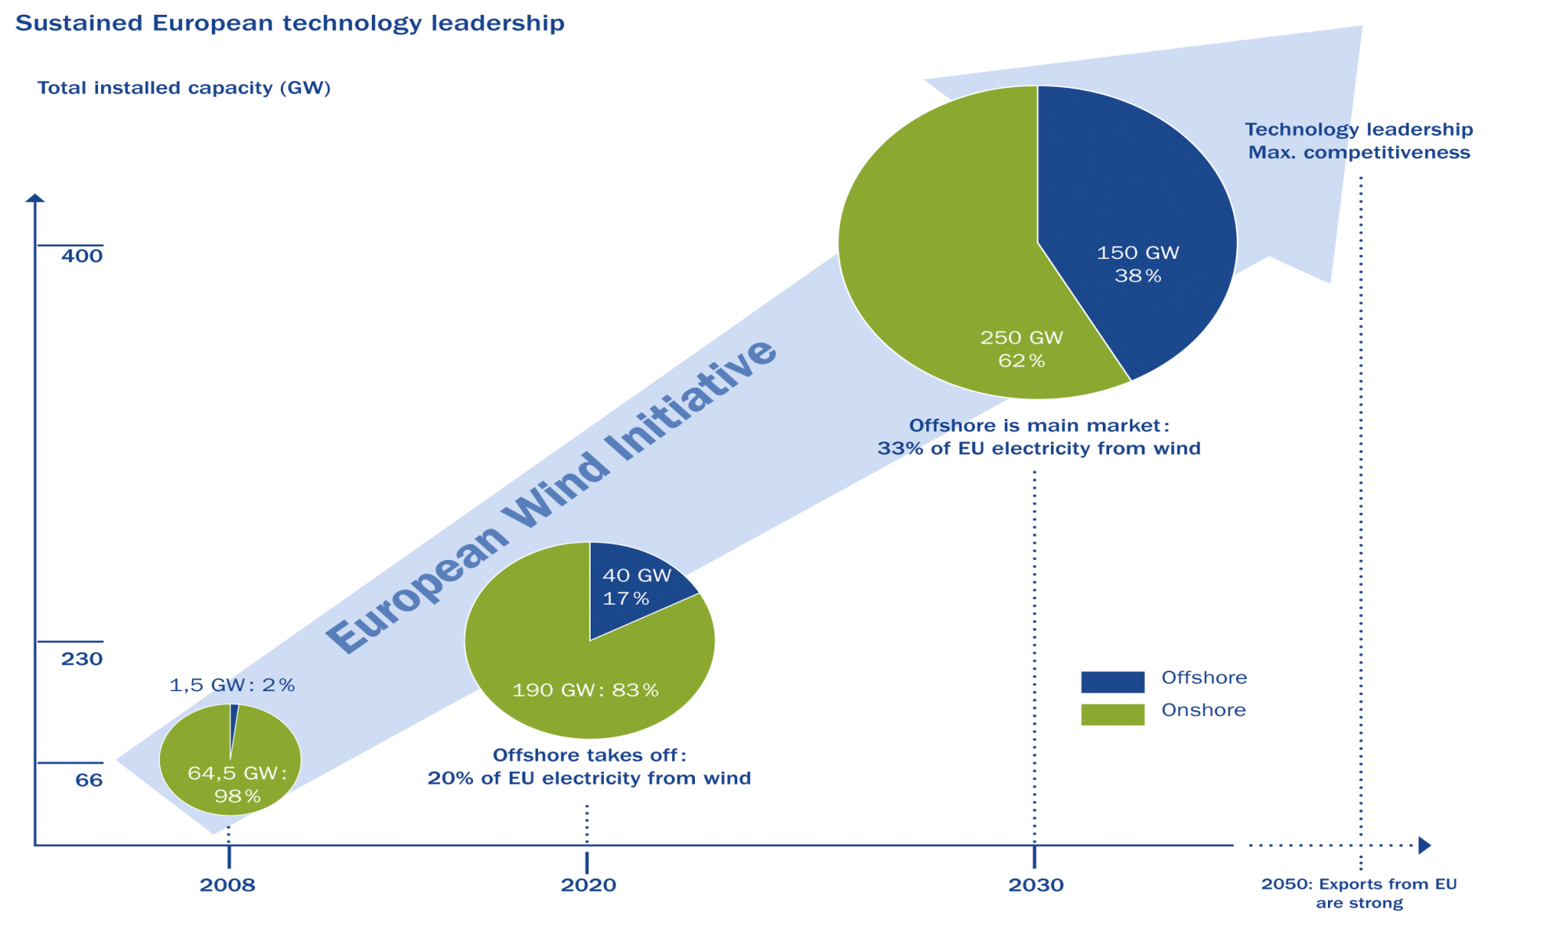
The EWI: expected impact on the sector

Slide 22
Thank you

